Slide 1
QUEUE

Slide 2
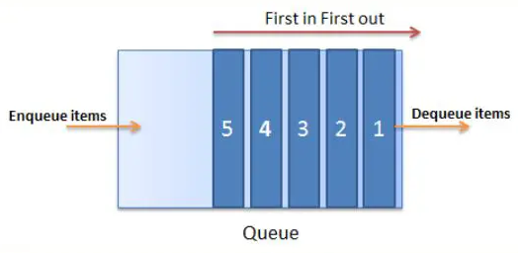
What is a Queue
The Non-Generic Queue Collection Class in C# works in the FIFO(First-In-First-Out) principle. So, we need to use the Non-Generic Queue Collection class in C#, when we need First-In-First-Out access to the items of a collection. That means the item which is added first will be removed first from the collection. When we add an item to the queue, then it is called enqueuing an item. Similarly, when we remove an item from the queue then it is called dequeuing an item.
In order to understand Queue collection, first, we need to understand the FIFO Principle as Queue works on the FIFO Principle. Let us understand the FIFO principle with an example. Imagine a queue of people waiting for a ticket in a cinema hall. Normally, the first person who enters the queue will be the first person to get the ticket from the counter. Similarly, the last person who enters the queue will be the last person to get the ticket from the counter. For a better understanding, please have a look at the following image.
Queue is defined as both Generic and Non-Generic types of Collections in C#. The Generic Queue Collection is defined in System.Collections.Generic namespace whereas Non-Generic Queue Collection is defined under System.Collections namespace.

Slide 3

Creating a Queue
Queue(): It is used to initialize a new instance of the Queue class that is empty and has the default initial capacity, and uses the default growth factor.

Slide 4
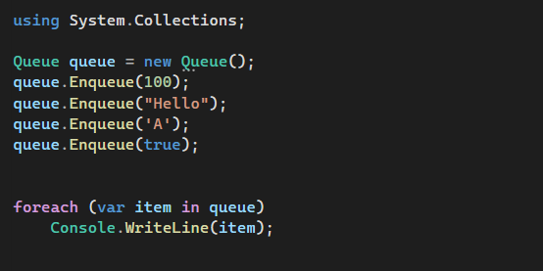
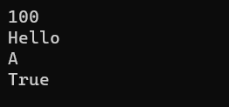
How to Add Elements into a Queue
If we want to add elements to a queue, then we need to use the Enqueue() method of the Queue class.
Enqueue(object obj): This method is used to add an object to the end of the Queue. Here, the parameter obj specifies the object to add to the Queue. The value can be null

Slide 5
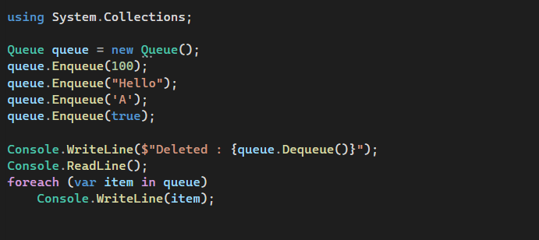
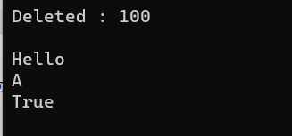
How to Remove Elements from the Queue Collection in C#?
If you want to remove elements from the queue, then you need to use the following two methods provided by the Non-Generic Collection Queue class.
Dequeue(): This method is used to remove and return the object at the beginning of the Queue. It returns the object that is removed from the beginning of the Queue.
Clear(): This method is used to remove all objects from the queue.

Slide 6
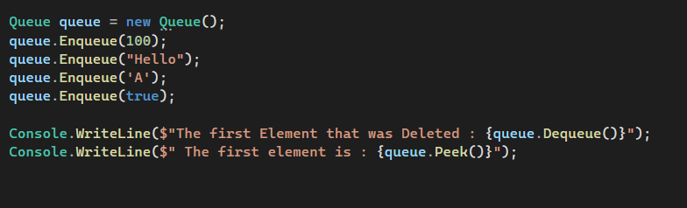

Get the First Element in the Queue
Dequeue(): The Dequeue() method of the Queue class is used to Remove and return the object from the beginning of the Queue. If there is no object (or element) present in the Queue and if we are trying to remove an item or object from the Queue using the pop() method then it will throw an exception i.e. System.InvalidOperationException
Peek(): The peek() method of the Queue class is used to return the oldest object i.e. the object present at the start of the Queue without removing it. If there is no object (or element) present in the Queue and if we are trying to return an item (object) from the Queue using the peek() method then it will throw an exception i.e. System.InvalidOperationException

Slide 7
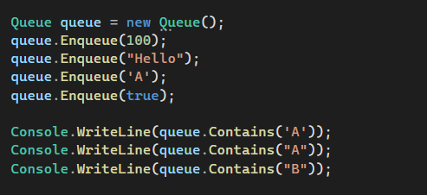

Check Whether an Element Exists in a Queue
Contains(object obj): This method is used to determine whether an element is in the Queue. Here, the parameter obj specifies the object or element to locate in the Queue. The value can be null. It returns true if obj is found in the queue; otherwise, false.

Slide 8
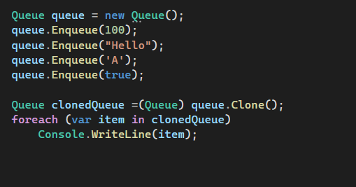
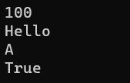
clone
Clone(): This method is used to create and return a shallow copy of a Queue object.

Slide 9
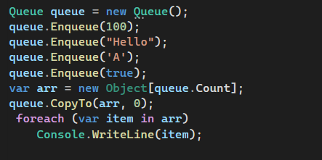
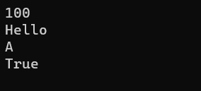
CopyTo
CopyTo(Array array, int index): The CopyTo method of the Non-Generic Queue Collection Class in C# is used to copy the System.Collections.Queue elements to an existing one-dimensional System.Array, starting at the specified array index. Here, the parameter array specifies the one-dimensional Array that is the destination of the elements copied from Queue. The Array must have zero-based indexing. The index parameter specifies the zero-based index in the array at which copying begins. If the parameter array is null, then it will throw ArgumentNullException. If the parameter index is less than zero, then it will throw ArgumentOutOfRangeException.

Slide 10
Properties of Queue Class
Count: It gets the number of elements contained in the Queue.
IsSynchronized: It gets a value indicating whether access to the Queue is synchronized (thread-safe). It returns true if access to the queue is synchronized (thread-safe); otherwise, false. The default is false.
SyncRoot: It gets an object that can be used to synchronize access to the Queue. It returns an object that can be used to synchronize access to the queue.

Slide 11
Non-Generic Queue Collection Class in C# Overview
The following are some important points that you need to remember while working with Queue Collection.
In C#, Queues are used to store a collection of objects in a FIFO (First in, First out) style, i.e., the element which is added first will remove first.
By using Enqueue() method, we can add elements at the end of the queue.
The Dequeue() method will remove and return the first element from the queue.
The queue Peek() method will always return the first element of the queue, and it won’t delete elements from the queue.

